Slide 1
Orlando – Florida UserCon

Slide 2
Business Continuity and Disaster Recovery: How to Prepare for a Disaster

Slide 3



Business Continuity and Disaster Recovery/Management: How to Prepare
Eric Kubla
IT Server Manager at First Commonwealth Bank
Based out of Indiana, PA. Cincinnati to just west of Philly
11+ years as a Pittsburgh VMUG @pghvmug leader
2023-2024 VMUG US East Regional Champion
10 years as a vExpert
VMUG Community Speaker – 18 UCs since 2023

Slide 4
Thank you for attending the Florida UserCon.
Take a pic during this session. Tweet it out with #MyVMUG, #vCommunity, #FLVMUG, @FLVMUG, @erickubla, and @MyVMUG.
Feel free to send me any questions
X - @erickubla
ekubla@gmail.com
Blog - https://erickubla.blogspot.com/
LinkedIn - https://www.linkedin.com/in/eric-kubla

Slide 5
Types of Disasters
Natural Disasters
Hardware Malfunction
Power Outages
Human Error
Cyberattacks
Notes:
Hardware malfunction – UPS maintenance, cooling system, power outage/generator
Human error – CrowdStrike
Cyberattack – Malware/ransomware, data breach

Slide 6
What is a Disaster Recovery Plan/Business Continuity Plan?
DRP – Documented, tested approach that outlines how an organization can quickly and efficiently resume operating after an unplanned outage.
BCP - Completing and verifying the DRP. Policies, procedures, strategies.
Notes:
A business continuity plan (BCP) focuses on keeping a business running during a disruption, while a disaster recovery plan (DRP) focuses on restoring operations after a disruption

Slide 7
NOT EVERY EVENT IS YOUR FAULT! But it’s probably your responsibility
Be involved
Communicate
Ask questions

Slide 8
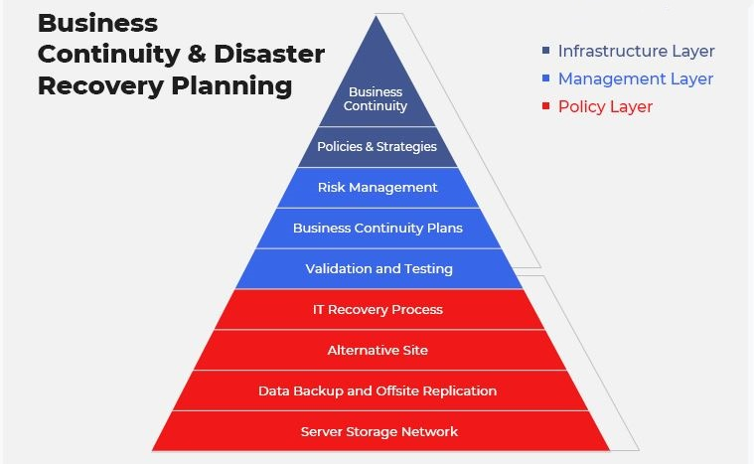
BC and DR Planning

Slide 9
PLANNING
Have a plan
Test your plan
Document your plan and testing
Resources
Risks
RPO/RTO
Budget?

Slide 10
Types of DR Plans
Virtual Environment
Network
Cloud
Data Center
Cloud Based DR

Slide 11
DR Plan Check List
Scope of Recovery
Documentation – Network, Server, etc
Identifying most critical assets
RPO/RTP information
Who is responsible for what – Take Ownership
Review previous unplanned events
Incident Response Team
Additional Emergency Steps

Slide 12
Building your DR Plan
BIA and Risk Analysis
Goals
Identify Teams
Inventory
Internal/External Communication Strategy
Backup, Recovery, Redundancy Plan
Test the Plan
Review and Revise
Notes:
BIA - a process where an organization identifies and assesses the potential negative impacts of disruptions to critical business functions, allowing them to determine which operations are most vital and prioritize recovery strategies in case of an emergency or disaster;
BIA/BCP - A business continuity plan (BCP) describes what steps must be taken in case of an outage or disruption, whereas a BIA identifies the risk that could prompt the outage

Slide 13
DR Testing Variations
Detailed Discussion – Cover all possible topics/scenarios, missing pieces
Tabletop Exercise – Walk through the steps. Ensure everyone knows their role. Helps app owners, C Level, non technical understand the process.
Simulated Testing – Different scenarios simulated in a controlled environment. Helps to gauge RPO/RTO and test process and documentation.
True DR Test – Failover prod apps/server to DR (or secondary) site and run production workloads and processes.

Slide 14
Prod vs dr Or primary vs secondary
Where do your apps run?
Can both sites support a full workload
Can you live without something?

Slide 15
Know what’s in your Data Center
File servers/home directories
Virtual Desktops
Veeam Server & Backup Config File
VPN/Network Equipment
Servers – Active/Active

Slide 16
Business Continuity Team
Who’s on the Team
Who manages the team?
Expectations from other departments/application owners
Educate them
Expectations vs. Reality

Slide 17
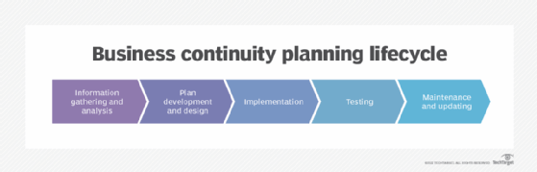

Slide 18
BCP Steps
Oversight/Committee
Conduct the Business Impact Analysis
Details
Action
Notes:
Oversight - Decide who will oversee the plan. Ideally, a BCP committee or business continuity team includes business, security and IT leaders.
BIA - a process where an organization identifies and assesses the potential negative impacts of disruptions to critical business functions, allowing them to determine which operations are most vital and prioritize recovery strategies in case of an emergency or disaster;

Slide 19
BCP - Details
Who is impacted by the disruption
Who is responsible for client/customer notification, emergency responders
How & When will customers, employees, and management be notified
Critical products and services -focus on restoring first?
Different BCPs per dept
Key vendors?
Notes:
Who is affected by a business disruption?
Who holds a hard copy of contact information for top customers and clients?
How and when will customers, employees and management be notified?
What are the alternative means of communication if phones go down?
Which employees are needed for the restoration of critical business functions and how will they be reached or relocated?
Which critical products and services should the company focus on restoring first?
What issues must be addressed within the first 24 to 48 hours?
Does every team and department have its own BCP? Who is in charge of each?
What's the emergency succession plan for senior staff, including the CEO?
Which employees will perform emergency tasks?
Where will off-site crisis meetings take place?
Who will interact with local emergency responders, such as firefighters and police?
Who are the key vendors, including data backup providers?

Slide 20
BCP - Actions
Initial Response – Defines how you will respond
Relocation – workloads, people
Recovery – RTO/RPO
Restoration
Notes:
Initial response. This defines how the company will respond to a business interruption within the first hours. This is the period when team members are contacted and the BCP is activated.
Relocation. During this stage, alternate facilities are activated and work-at-home policies implemented.
Recovery. Once personnel and equipment are relocated, the assessment of damage and monitoring of business recovery begins. The recovery strategy must consider the organization's recovery time objective (RTO), which is the maximum time IT systems can be down after a failure, as well as its recovery point objective (RPO), which is the maximum data loss the organization can tolerate.
Restoration. Personnel return to the original workplace or an alternate site. The company undertakes infrastructure verification, documents the incident and reviews lessons learned.

Slide 21
Conclusion/Key Takeaways
Have a plan and test it – DRP/BCP
Document Everything!
Be involved and know who else is or should be involved
Don’t Panic!

Slide 23
QUESTIONS?
X - @erickubla
ekubla@gmail.com
Blog - https://erickubla.blogspot.com/
LinkedIn - https://www.linkedin.com/in/eric-kubla

Slide 27







Elements

